Slide 1
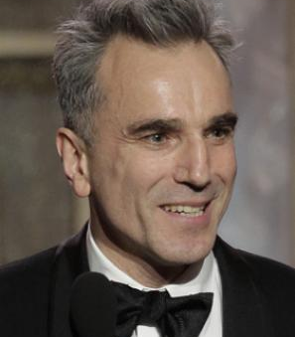
Daniel Day-Lewis Biography Film Actor, Theater Actor, Actor (1957–) English actor Daniel Day-Lewis is the only actor to win three Academy Awards for Best Actor. He earned Oscars for his roles in ‘My Left Foot,’ ‘There Will Be Blood’ and ‘Lincoln,' and nominations for 'Gangs of New York' and 'In the Name of the Father.' Who Is Daniel Day-Lewis? Daniel Day-Lewis was born on April 29, 1957, in London, England. He studied acting at the Bristol Old Vic and made his film debut in Sunday, Bloody Sunday. He was acclaimed for his role in My Beautiful Laundrette, and won Academy Awards for My Left Foot, There Will Be Blood and Lincoln. Day-Lewis married filmmaker Rebecca Miller, the daughter of photographer Inge Morath and playwright Arthur Miller, in 1996. The acclaimed performer announced his retirement from acting in June 2017.

Slide 2
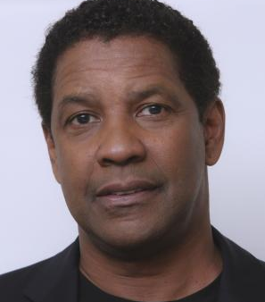
Denzel Washington Biography Film Actor, Actor, Television Actor, Filmmaker, Director (1954–) Former star of the hit TV drama 'St. Elsewhere,' actor/director Denzel Washington has earned popular and critical acclaim for his roles in an array of feature films, including 'Glory,' 'Malcolm X,' 'Training Day,' 'American Gangster' and 'Flight.' Who Is Denzel Washington? Born in Mount Vernon, New York, on December 28, 1954, Denzel Washington first studied journalism at Fordham University but then discovered an interest in acting. He made his feature film debut in the comedy A Carbon Copy (1981) and was cast on the hit TV medical drama St. Elsewhere (1982-8). He went on to appear in several hit movies, including Philadelphia, Man on Fire, The Book of Eli, American Gangster and Flight, and won Oscars for his roles in Glory and Training Day. He received an Oscar nomination for his starring role in 2016's Fences, an adaptation of August Wilson's Tony and Pulitzer Prize-winning play, and for the 2017 film Roman J. Israel, Esq.

Slide 3
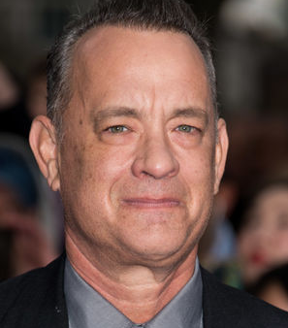
Tom Hanks Biography Director, Actor, Television Actor, Film Actor (1956–) Former sitcom actor Tom Hanks is the much-beloved star of such Hollywood hits as 'Splash,' 'Big,' 'Forrest Gump,' 'Apollo 13,' 'Toy Story' and many more. Who Is Tom Hanks? Born on July 9, 1956, in Concord, California, actor Tom Hanks began performing with the Great Lakes Shakespeare Festival in 1977, later moving to New York City. He starred in the television sitcom Bosom Buddies, but became far more known when he starred in the Ron Howard film Splash. He went on to star in many more popular and acclaimed movies, including Big, Forrest Gump and Cast Away, en route to becoming one of the most powerful and well-respected actors in Hollywood.

Slide 4
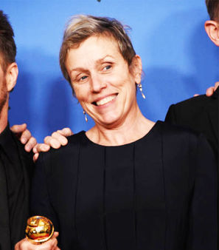
Frances McDormand Biography Film Actor/Film Actress, Television Actress, Film Actress, Actress (1957–) Actress Frances McDormand is known for her Oscar-winning roles in 'Fargo' and 'Three Billboards Outside Ebbing, Missouri,' as well as for acclaimed turns in 'Almost Famous' and the miniseries 'Olive Kitteridge.' Who Is Frances McDormand? Born in 1957 in Chicago, Illinois, Frances McDormand studied at Yale Drama School and shared a dorm room with Holly Hunter. She met Joel and Ethan Coen through Hunter and won a lead in their first film, Blood Simple. McDormand received her first Academy Award nomination for her role in 1988's Mississippi Burning and broke through with an Oscar for her memorable turn in 1996's Fargo. Along with her acclaimed roles in 2000's Almost Famous and 2005's North Country, McDormand earned an Emmy for the 2014 HBO miniseries Olive Kitteridge and later grabbed a second Best Actress Oscar for her performance in 2017's Three Billboards Outside Ebbing, Missouri.

Slide 5
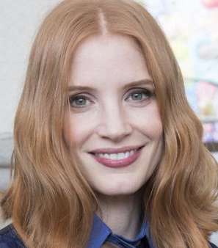
Jessica Chastain Biography Actress (1977–) Jessica Chastain is an award-winning actress who has gained widespread attention in 2011 for her work in ''The Help,' 'Tree of Life' and 'Zero Dark Thirty.' Who Is Jessica Chastain? Born on March 24, 1977, in Sacramento, California, Jessica Chastain attended Juilliard and then began landing roles on TV shows such as ER and Veronica Mars. Her acting career took off in 2011 when she appeared in the blockbuster The Help, earning a supporting actress Oscar nod for the role, and the lauded Tree of Life. She has since won a Golden Globe and earned another Academy Award nomination, specifically for lead actress in the Kathryn Bigelow film Zero Dark Thirty. Additional projects include Interstellar, A Most Violent Year and Crimson Peak.

Slide 6
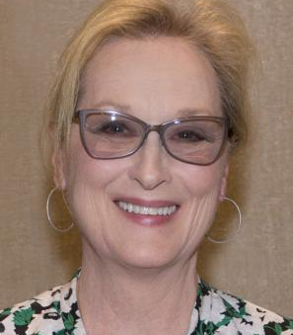
Meryl Streep Biography Film Actor/Film Actress, Film Actress, Actress (1949–) Oscar-winning actress Meryl Streep is one of the most esteemed stars of the screen, known for her work in such diverse films as 'Sophie's Choice,' 'The Deer Hunter,' 'The Devil Wears Prada,' 'Mamma Mia!' and 'Doubt.' Who Is Meryl Streep? Meryl Streep was born on June 22, 1949, in Summit, New Jersey. She began her career on the New York stage in the late 1960s and appeared in several Broadway productions. Streep transitioned to films in the 1970s and soon began earning major accolades, eventually winning Oscars for Kramer vs. Kramer, Sophie's Choice and The Iron Lady, among a league of nominations. Equally able to wow audiences in drama, comedy and musicals, she has come to be considered one of the greatest actresses of our time.

Slide 7
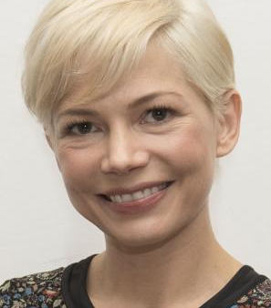
Michelle Williams Biography Theater Actress, Television Actress, Film Actor/Film Actress, Actress, Film Actress (1980–) Michelle Williams first came to stardom as a star of teen drama 'Dawson's Creek.' She rose to critical acclaim with films such as 'Blue Valentine' and 'Brokeback Mountain.' Who Is Michelle Williams? Actress Michelle Williams got her start as a teen TV idol on the show Dawson's Creek. The performer emancipated herself from her family at the age of 16 in order to advance her career in Hollywood. She went on to receive critical acclaim for her Oscar-nominated performances in Brokeback Mountain (2005), Blue Valentine (2010), My Week with Marilyn (2011) and Manchester by the Sea (2016).

Slide 8
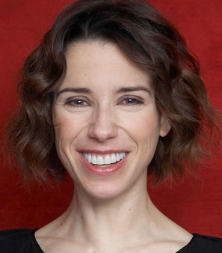
Sally Hawkins Biography Film Actress, Actress, Film Actor/Film Actress (1976–) Golden Globe-winning actress Sally Hawkins has appeared in several critically acclaimed films, including 'Happy-Go-Lucky,' 'Blue Jasmine' and 'The Shape of Water.' Who Is Sally Hawkins? Born in London, England, in 1976, actress Sally Hawkins studied her craft at the famed Royal Academy of Dramatic Art. A notable early film role came in Mike Leigh's All or Nothing (2002), and she later reteamed with Leigh for Happy-Go-Lucky (2008), for which she won a Golden Globe Award. Hawkins garnered more awards buzz for her work in Woody Allen's Blue Jasmine (2013), and Guillermo del Toro's The Shape of Water (2017).

